Slide 1

Telecom 5G Performance Analysis
KPI dashboard for a telecom company

Slide 2
Business Objective
AtliQo is one of the largest telecom providers in India, offering 4G and 5G services across several cities.
The Managing Director/CEO of AtliQo aims to understand the impact of the 5G rollout on the company’s key performance indicators, focusing on areas such as user engagement, subscription trends, and overall revenue fluctuations.
To address these concerns, it was decided to create a KPI Dashboard using data from before and after the 5G launch. The goal was to compare key metrics such as revenue, active users, and unsubscribed users to assess the impact of the 5G rollout.
The dashboard will enable management to track key performance indicators (KPIs) and guide strategic decisions to optimize service offerings and enhance user retention based on insights from the data.

Slide 3

Problem statement ------------------- project scope
Implement filters for city-wise and period-specific comparisons to provide detailed insights.
Identify data sources related to user engagement, revenue trends, and subscription metrics to analyze the impact of 5G on AtliQo’s business performance.
Clean and transform the data collected pre- and post-5G launch to ensure consistency and accuracy for analysis.
Create a dashboard that compares key performance indicators (KPIs) such as revenue, average revenue per user (ARPU), active and unsubscribed users.
The dashboard should offer both high-level overviews and in-depth analysis to help management understand critical business metrics and trends, facilitating informed decision-making to recover growth.

Slide 4
SOLUTION APPROACH
Relationships: The relationships between tables were established within Power Pivot, enabling easy navigation across different dimensions and facts.The dashboard should offer both high-level overviews and in-depth analysis to help management understand critical business metrics and trends, facilitating informed decision-making to recover growth.
Tables and Relationships: There are 5 tables provided, including 3 dimension tables (dim_date, dim_cities, dim_plan) and 2 fact tables (fact_atliq_metrics, fact_plan_revenue), which track revenue and market share performance.
Tools Used: Power BI was used to create the dashboard, with data imported and transformed using Power Query.
Data Transformation: The necessary transformations were performed to allow analysis across different metrics like city-wise market share, ARPU, and plan-based revenue.

Slide 5
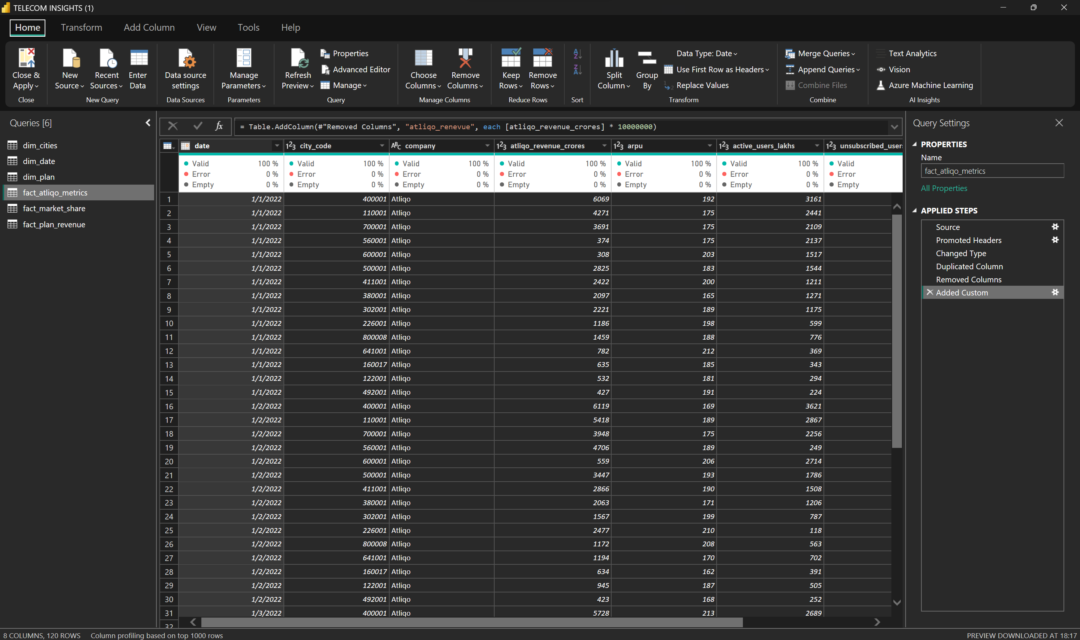
Data cleaning/ transformation in power query

Slide 6
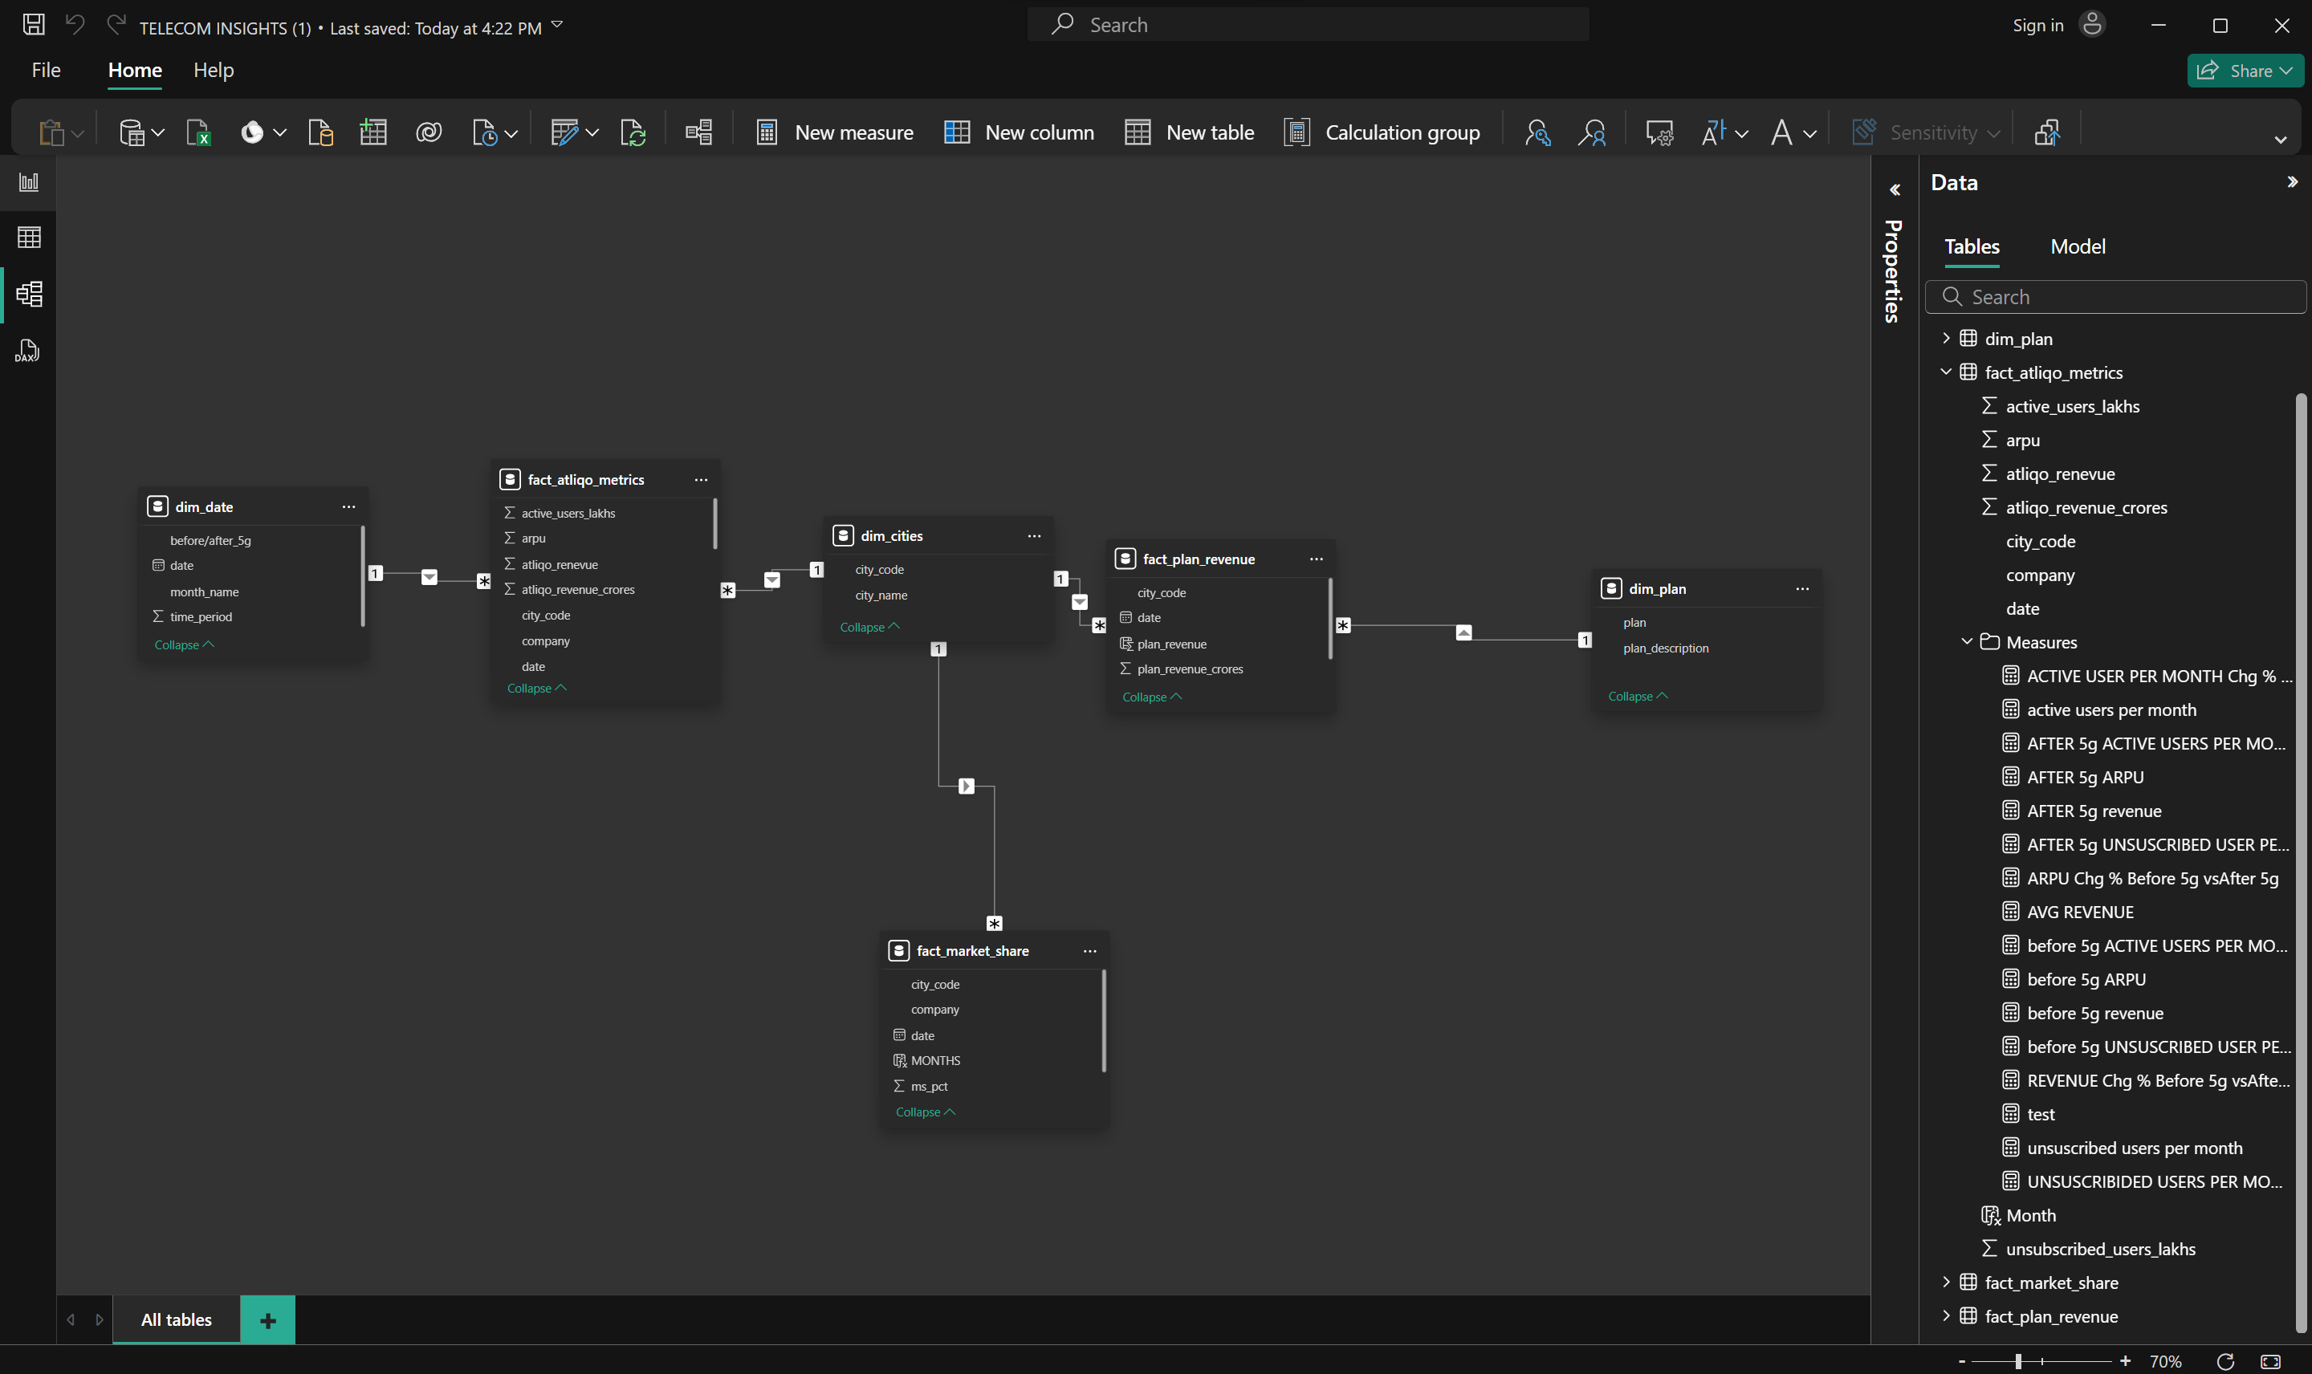
DATA MODELING

Slide 7
SOLUTION APPROACH
A few measures were created to calculate the KPIs as shown below:
Market Share (%) =
(Total users in specific city or region / Total revenue ) *100
Revenue Growth (%) =
(Revenue in the current period / revenue in the previous period) * 100
Active Users Growth Rate (%) =
(Total active users in the current period/Total active users in the previous period) *100.
ARPU ( Average Revenue per User) =
Total Revenue / Total Active Users
Revenue per Plan (%) =
Revenue generated for specific plan / total revenue ) * 100

Slide 8
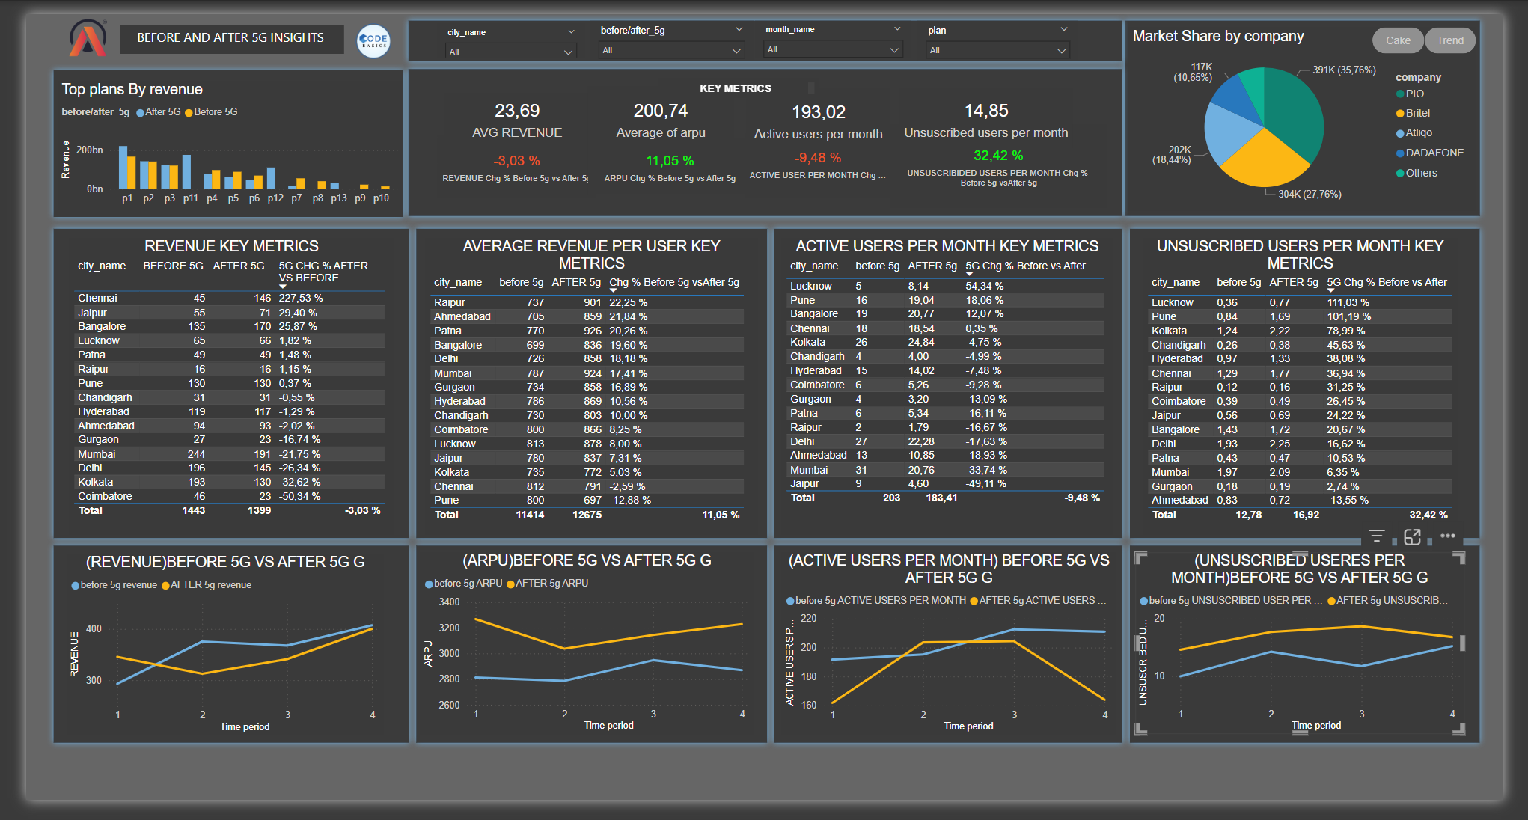
DASHBOARD

Slide 9

Features of the dashboard
Revenue Breakdown by Plan: Bar chart highlighting revenue comparisons for different plans before and after the introduction of 5G.
Key Metrics Summary: Revenue: Displays the average revenue before and after 5G. Average Revenue Per User (ARPU): Shows average revenue per user and percentage change post-5G. Active Users Per Month: Shows total active users and change rate before and after 5G. Unsubscribed Users Per Month: Tracks user churn with change percentage due to 5G.
Revenue Key Metrics Table: A table summarizing revenue changes across cities with comparisons between the pre-5G and post-5G periods.
ARPU Key Metrics: Table showcasing ARPU across cities, emphasizing percentage change due to 5G.

Slide 10
Features of the dashboard
User Engagement:
Active Users Per Month: Table showing active user counts before and after 5G.
Unsubscribed Users: A table showing unsubscribed users before and after 5G, offering churn insights..
Market Share by Company: Pie chart showing the market share distribution among telecom companies post-5G launch..
Trend Graphs: Revenue Trends: Line chart comparing revenue trends before and after 5G over different time periods. ARPU Trends: Line chart showing changes in ARPU before and after 5G. Active and Unsubscribed User Trends: Line charts visualizing the impact of 5G on active and unsubscribed users over time

Slide 11
Business outcomes
Slight Decline in Overall Revenue: Total revenue decreased by 3.03% after 5G deployment, indicating possible challenges in monetizing the new service or increased competition. Strategic adjustments may be needed to maximize revenue, especially in cities where revenue dropped significantly, like Coimbatore and Mumbai.
ARPU Increase: The average revenue per user (ARPU) rose by 11.05% post-5G, which suggests that although the overall revenue dropped, individual users may be spending more. Leveraging this insight, targeted marketing could focus on high-value customers to sustain and boost ARPU.
Reduction in Active Users: Active users per month decreased by 9.48%, reflecting a potential reduction in user engagement or increased customer churn after 5G implementation. Retention strategies, perhaps through improved service offerings or loyalty programs, might help stabilize this trend.

Slide 12
Business outcomes
Significant Rise in Unsubscribed Users: Unsubscribed users per month increased by 32.42%. This could indicate issues with the 5G experience or unmet customer expectations. Identifying common concerns among unsubscribing users and implementing measures to address them could be critical for reducing churn.
City-Specific Revenue Trends: Certain cities like Chennai and Jaipur experienced significant revenue growth post-5G, whereas others, such as Coimbatore and Mumbai, saw large declines. A city-focused approach may help capitalize on growth areas while addressing challenges in declining markets.
Competitive Market Share: PIO maintains the largest market share, with Britel and DADAFONE also holding substantial portions. Market share trends over time show competitive fluctuations, suggesting a dynamic market. Atliq could develop targeted competitive strategies to increase market penetration in regions where they are underrepresented.

Slide 13
CONCLUSIONS
The deployment of 5G has shown mixed results for the business. While the average revenue per user (ARPU) increased, indicating greater spending per customer, the total revenue slightly declined, and both active users and customer retention rates suffered. This suggests that the introduction of 5G alone was not sufficient to drive overall growth. Key areas for improvement include addressing user engagement and churn, especially in cities where 5G adoption led to significant revenue drops. Additionally, competitive dynamics highlight the need for targeted strategies to strengthen market position.
To fully realize the potential of 5G, the company should focus on enhancing customer experience, particularly for high-value users, and implement retention strategies to stabilize active user numbers. Adapting to market-specific needs and increasing competitive presence in underperforming areas could also drive better outcomes.

Slide 14
Thank you!

